Slide 1

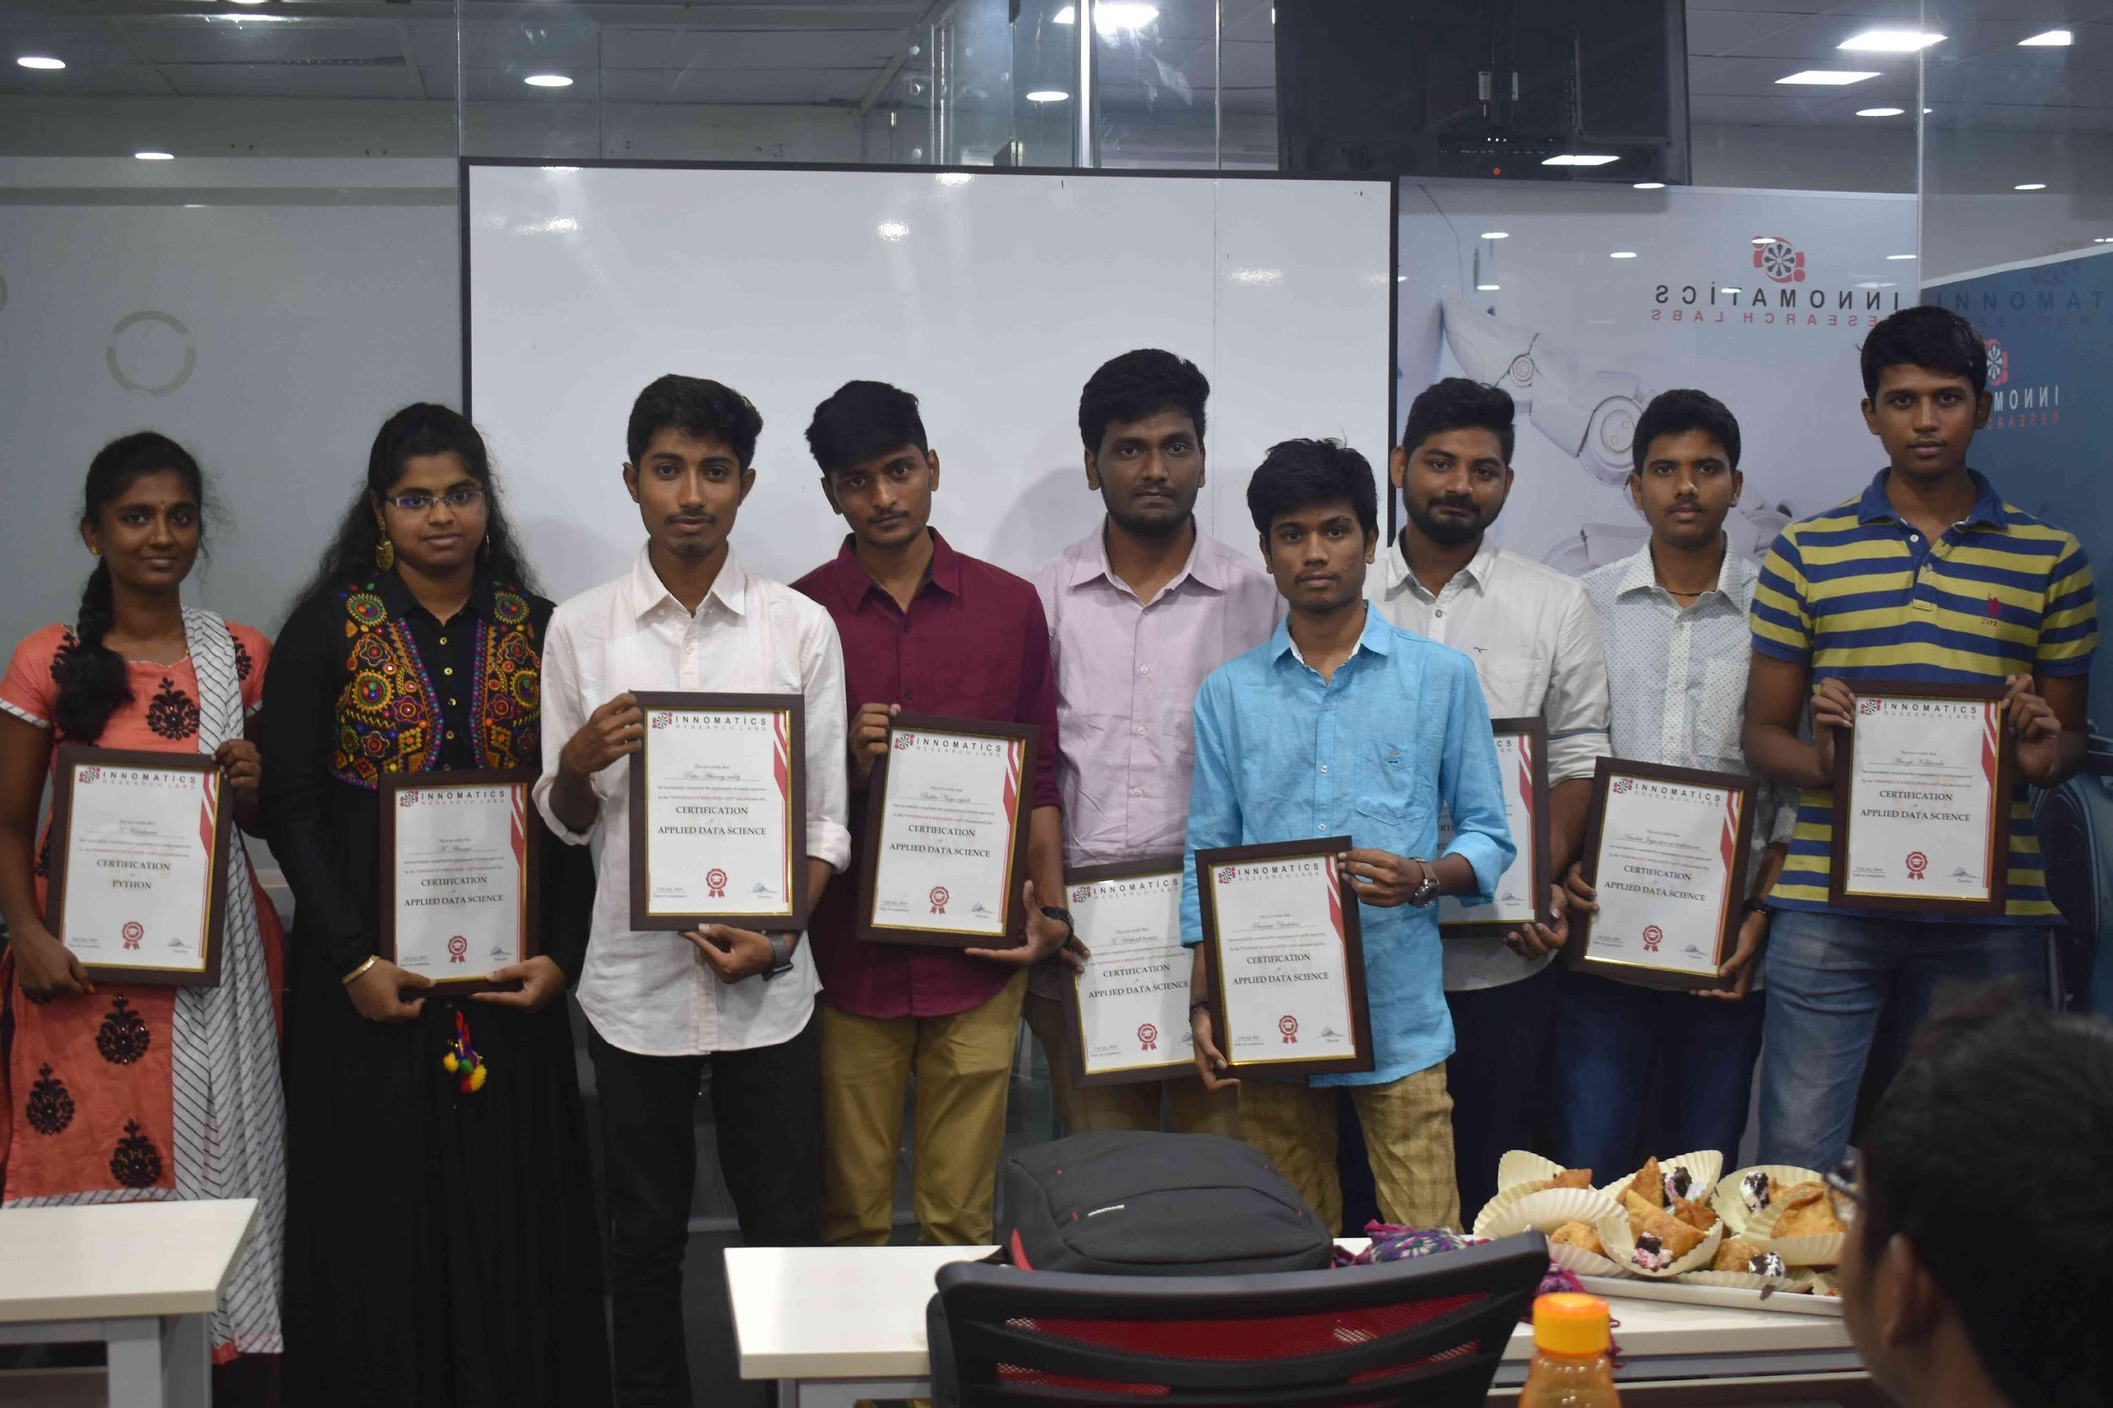
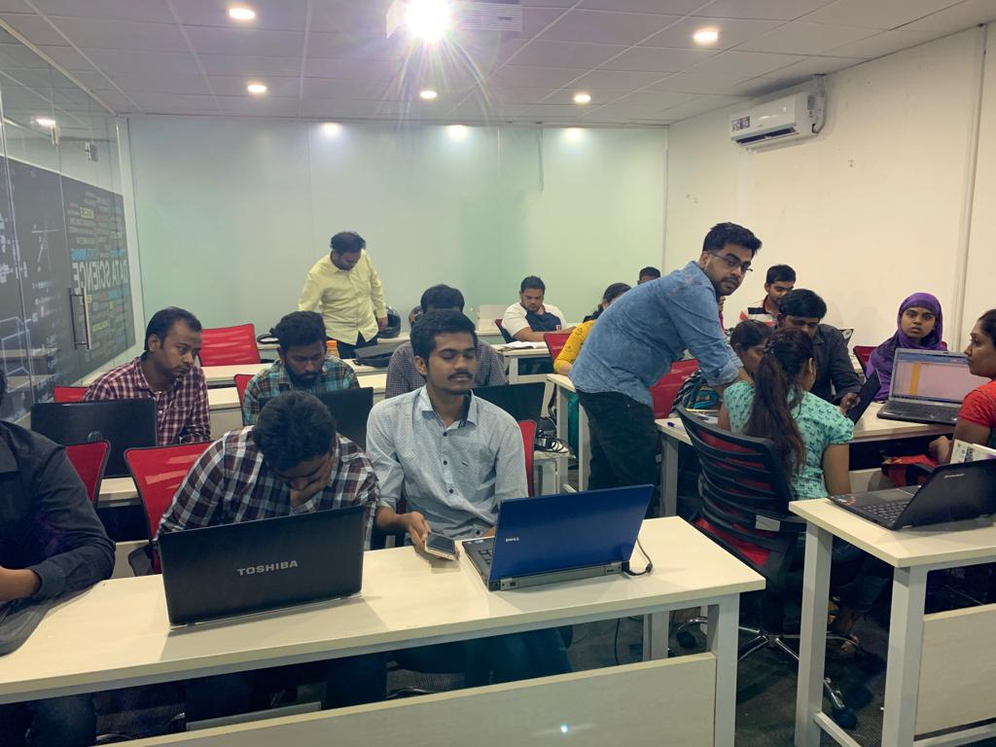

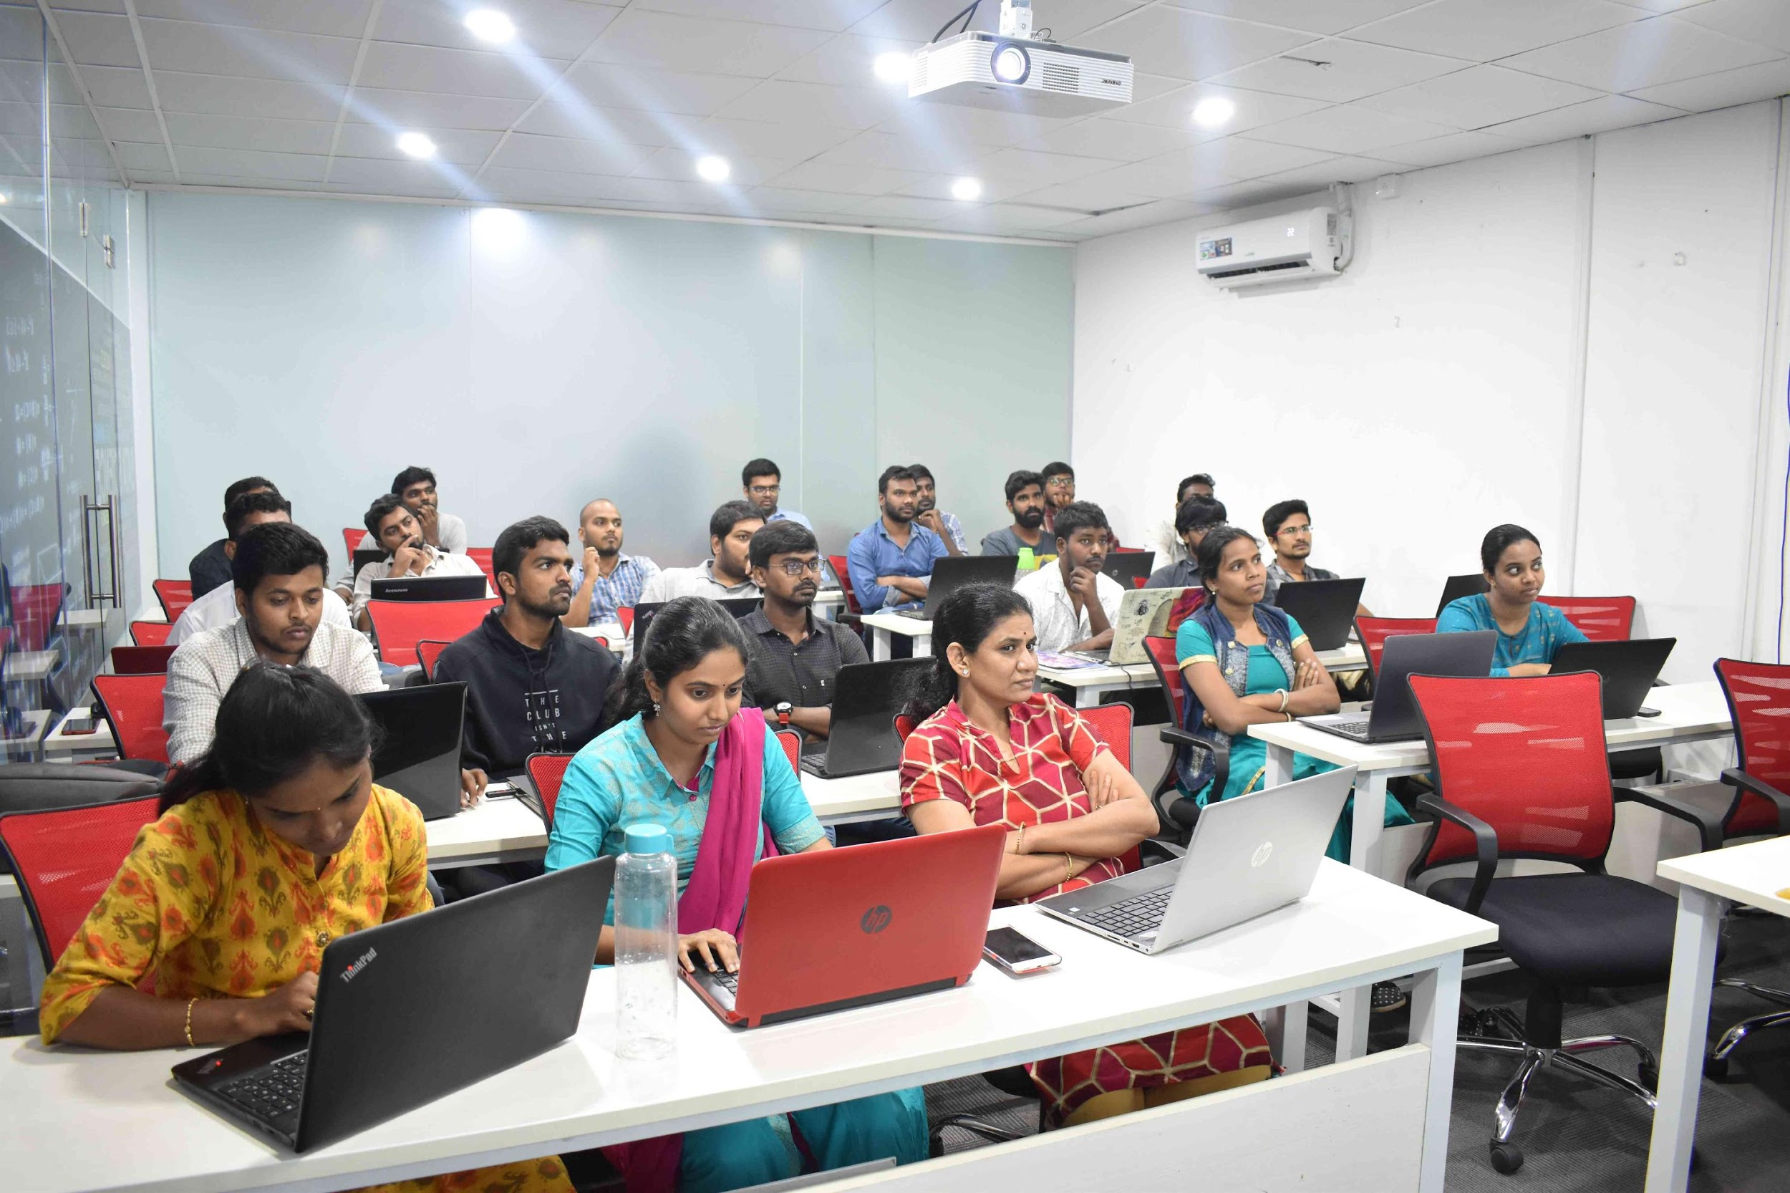
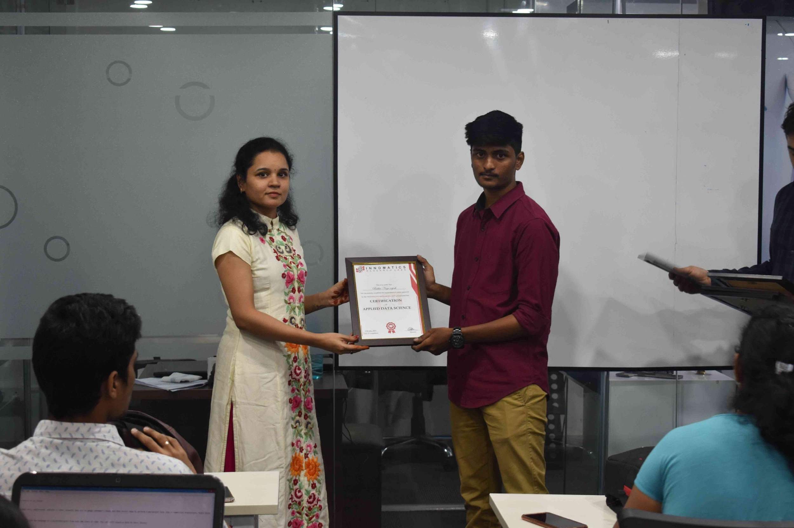
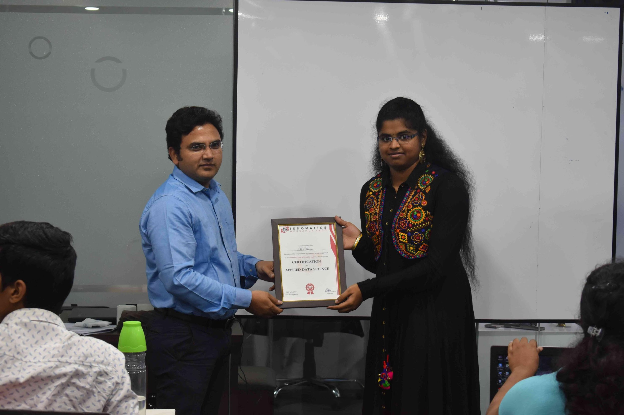

Slide 2
About Team :
NAME: R. SAI PRIYA
QUALIFICATION: MSc – Applied Statistics
NAME: B. ANUDEEP
QUALIFICATION:B-Tech(Electronics & Communications Engineering)

Slide 3

WEB SCRAPPING AND EXPLORATORY DATA ANALYSIS ON

Slide 4
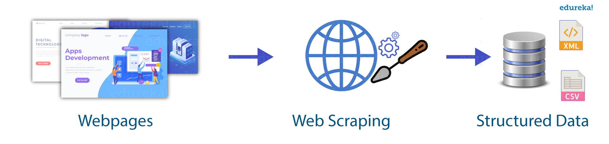
What is Web Scraping?
Web Scrapping also called “Crawling” or “Spidering” is the technique to gather data automatically from an online source usually from a website. While Web Scrapping is an easy way to get a large volume of data in a relatively short time frame.

Slide 5
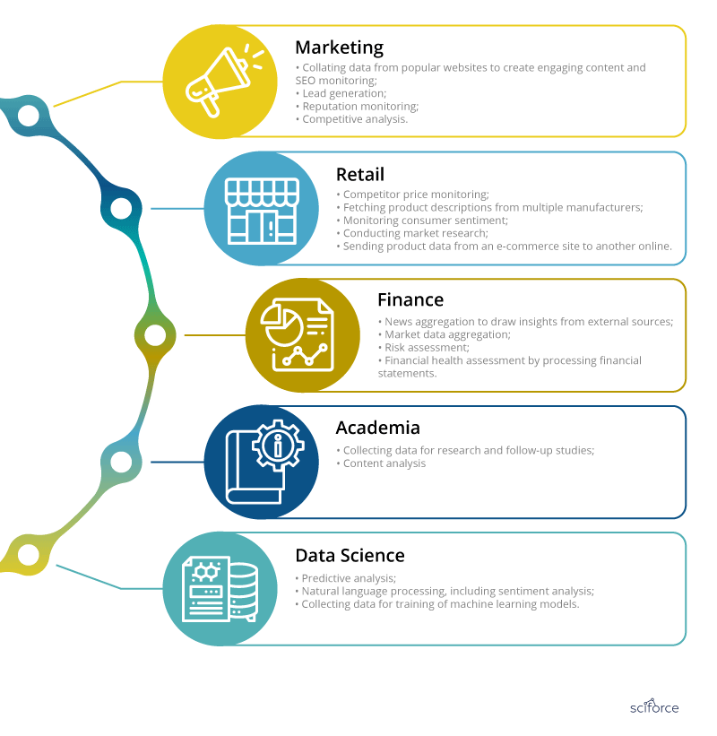
How Web Scraping is useful?
One can utilize the data collected from a website such as e-commerce portal, Job portals, social media channels to understand customer’s buying patterns, employee attrition behavior, and customer’s sentiments and the list goes on.

Slide 6
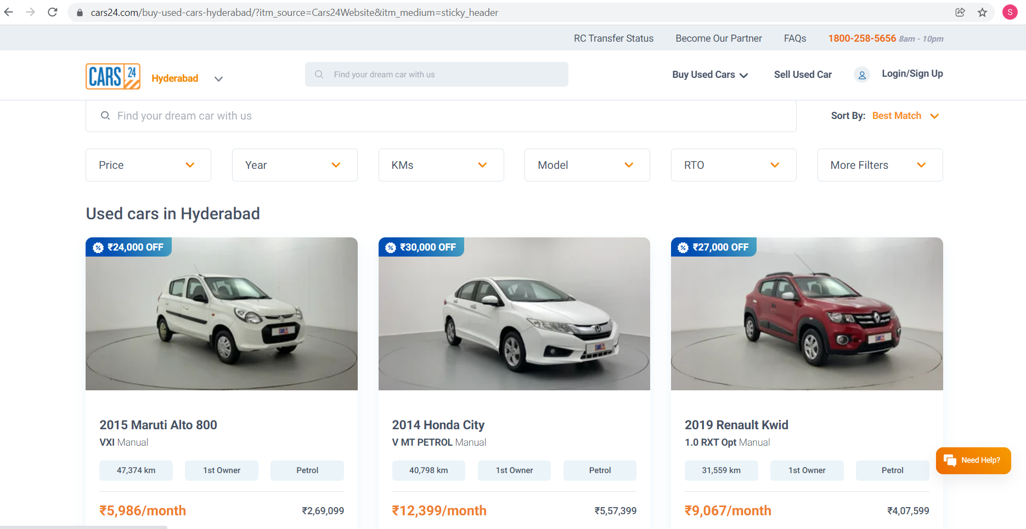
INTRODUCTION OF THE WEBSITE

Slide 7
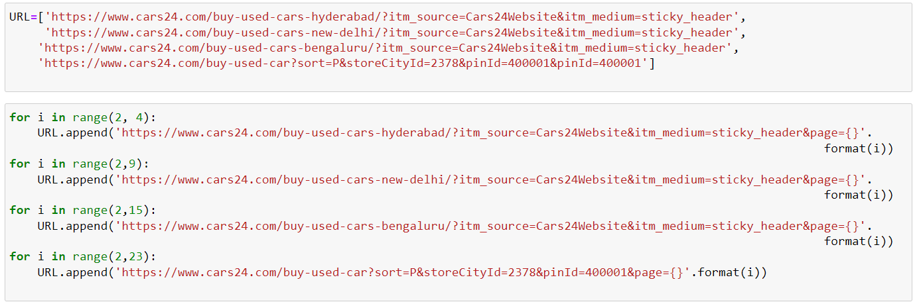
IDENTIFYING REQUIRED URL’S

Slide 8
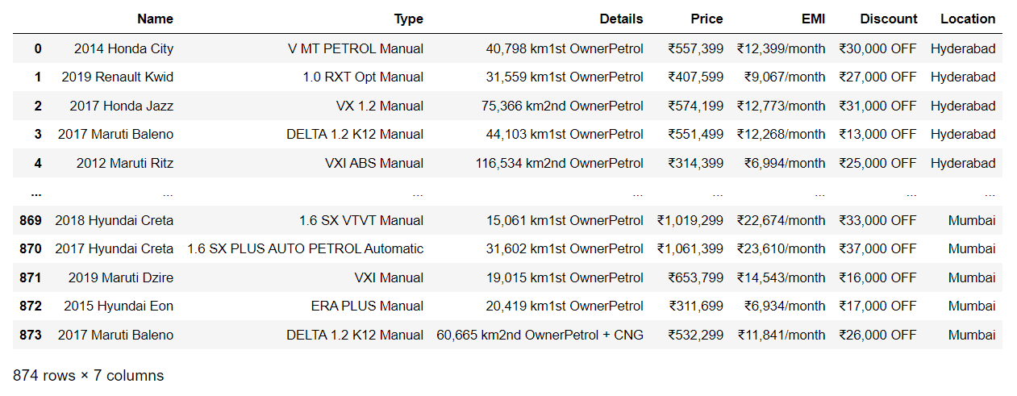
CREATION OF DATAFRAME

Slide 9
DATA CLEANING
Identifying Null Values.
Identifying Missing Values.
Treating rows and columns with null values and missing values.
Extracting required data from columns to create another columns using regular expressions.
Treating columns and converting required columns from object to int datatype.

Slide 10
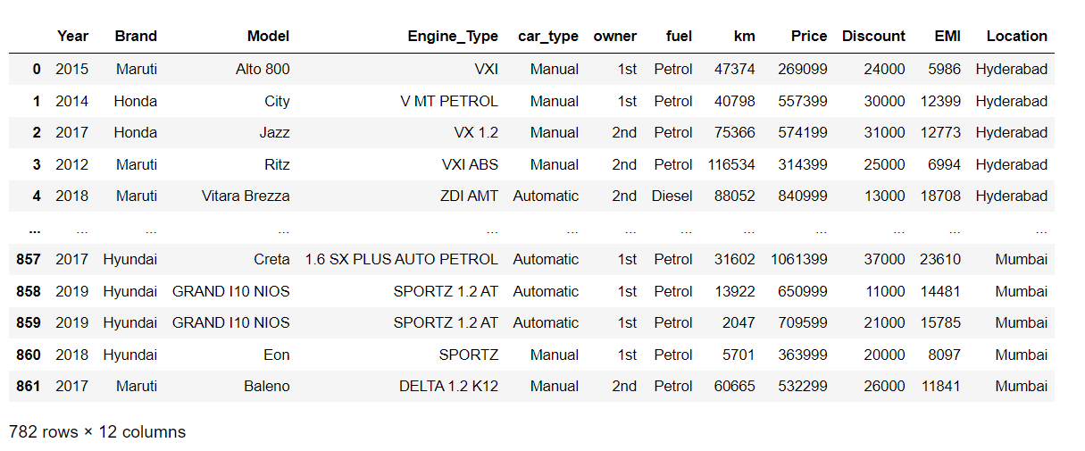
DATAFRAME AFTER CLEANING

Slide 11

VISUALIZATION

Slide 12
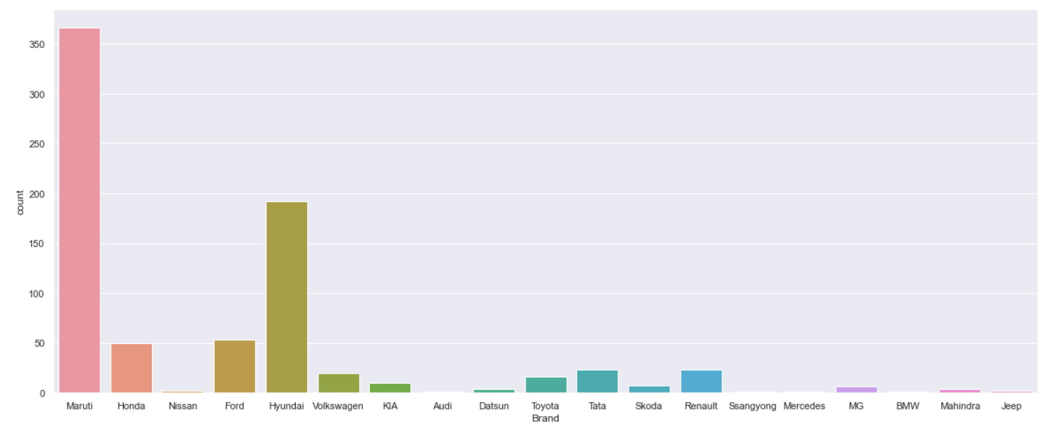
COUNT PLOT OF BRANDS
Most cars are of Maruti , Hyundai , Ford and Honda brand.

Slide 13
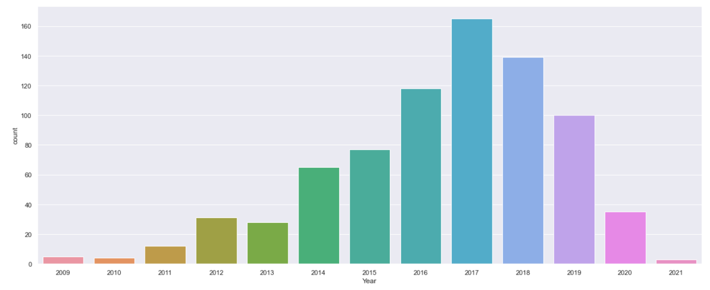
COUNT PLOT OF YEAR
Most of the cars are from 2017,2018,2016,2019.

Slide 14
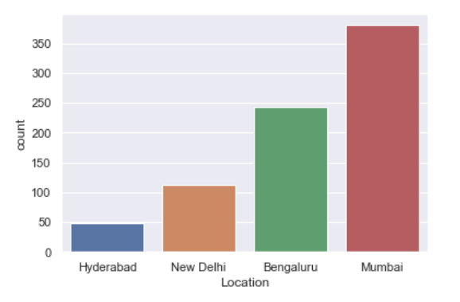
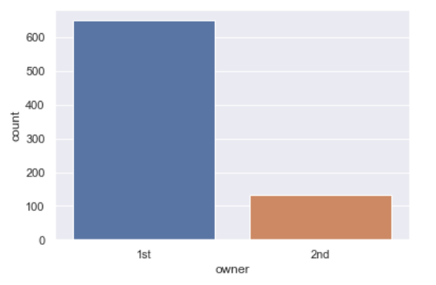
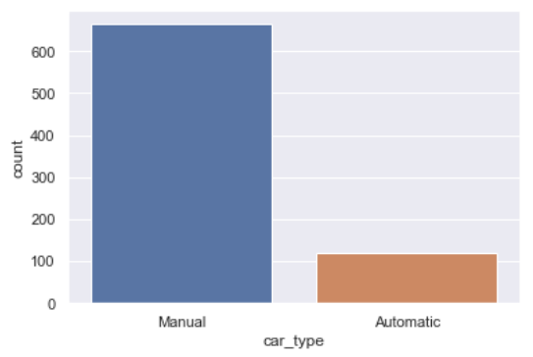
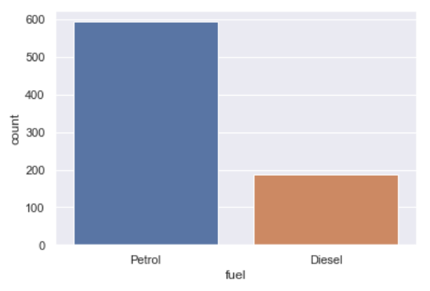
COUNT PLOTS OF LOCATION,OWNER,FUEL,CAR_TYPE COLUMNS

Slide 15
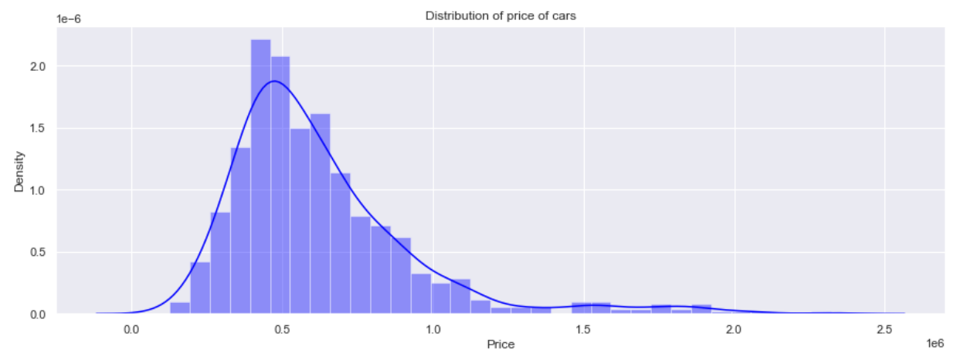
DISTRIBUTION PLOT OF PRICE COLUMN

Slide 16
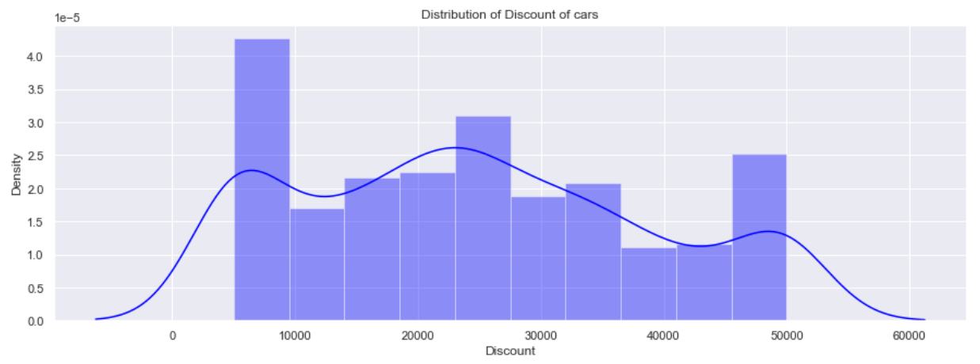
DISTRIBUTION PLOT OF DISCOUNT COLUMN

Slide 17
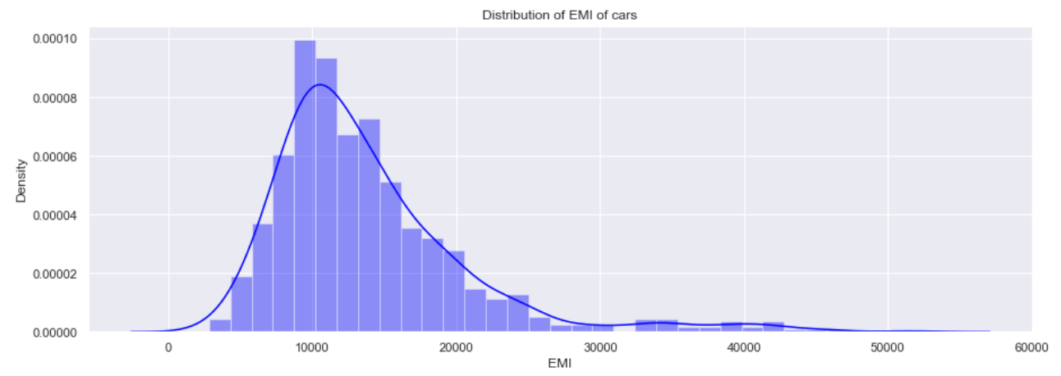
DISTRIBUTION PLOT OF EMI COLUMN

Slide 18
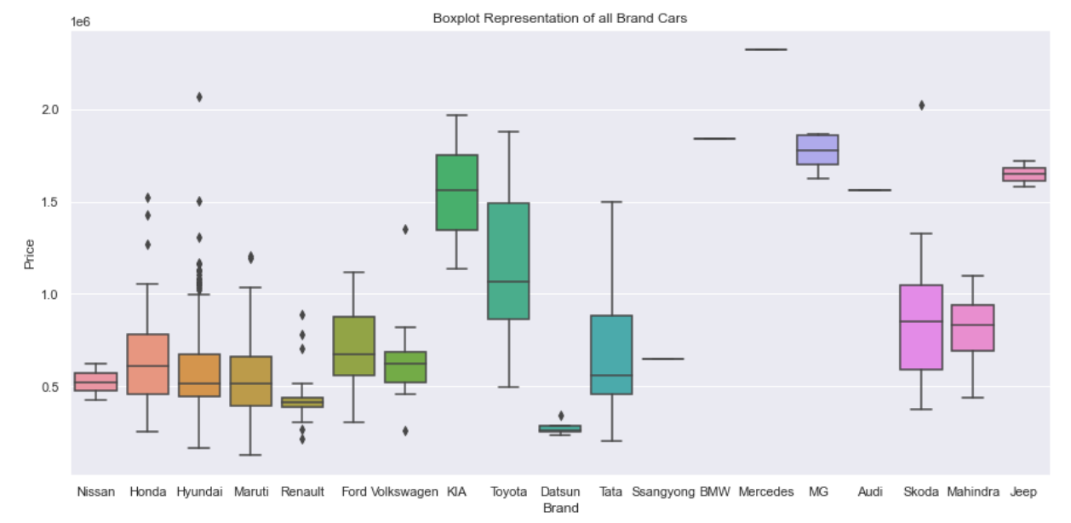
BOX PLOT OF ALL BRAND CARS

Slide 19
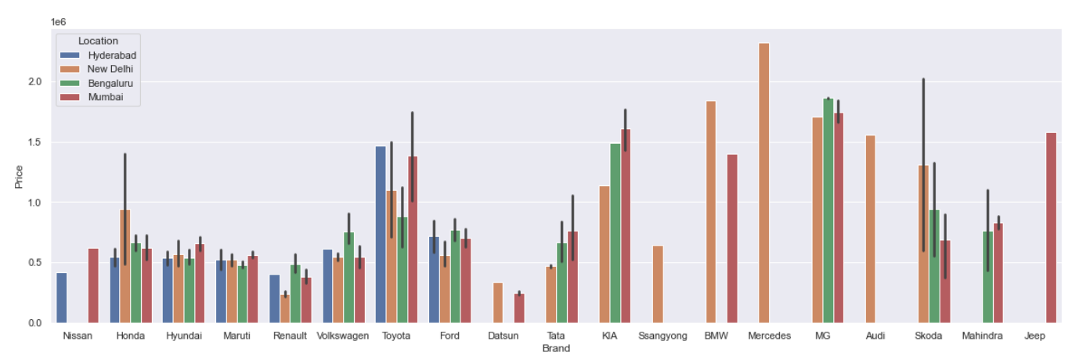
CITY WISE CAR PRICES

Slide 20
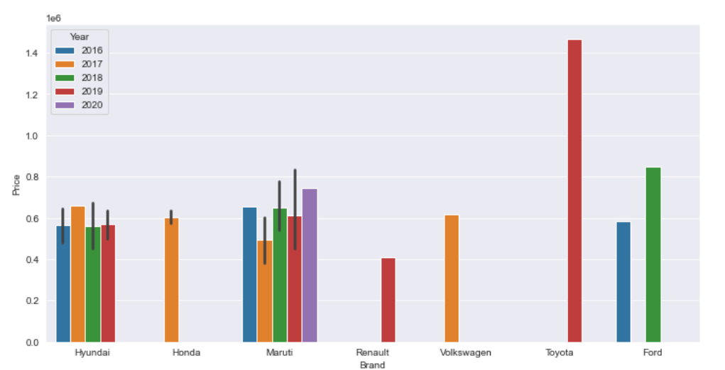
CARS AVAILABLE IN HYDERABAD

Slide 21
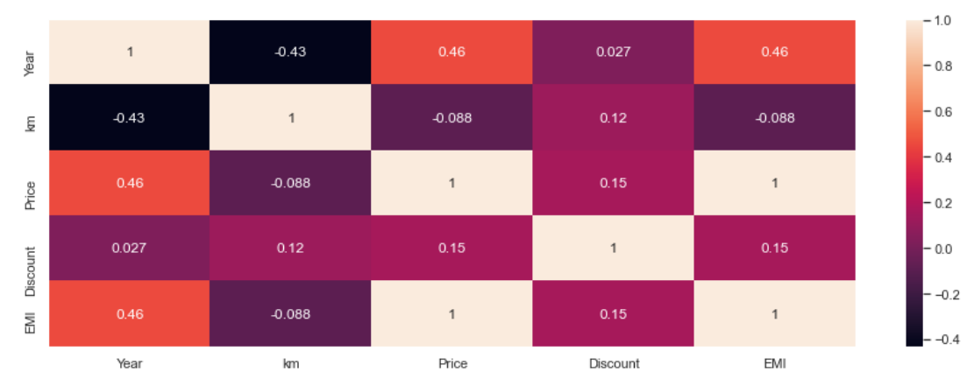
HEATMAP

Slide 22
INSIGHTS :
Maruti , Hyundai , Ford and Honda brand cars are higher.
Most of the cars are from 2017,2018,2016,2019.
Most car prices are in the range of 1,00,000-11,00,000.
Discounts are in the range of 5,000-50,000.
EMI’s are in the range of 5,000-25,000.
There are few costly cars available such as BMW , Mercedes and Skoda.
Most cars are of fuel , manual type and have first owners.

Slide 23

THANK YOU
THANK YOU

